Slide 1


Content Management Project for tourism agency
Done by: Nour Eldeen, Ahmed mahdy, Khaled nader and Ramez nabil
Supervised by: Dr.Essam Eliwa

Slide 2
Introduction
The web application is created to allow clients to view and book packages and to track their date. Also if users would like to check for a certain hotel's availability within a time frame which the user chooses. Furthermore, The web application lets the support center operator deal with guests and users enquiries about the trips , packages and hotels reservations.

Slide 3
Objectives
Guests/Users successfully book desired packages/hotels and track it's progress remotely, And being able to submit queries/comments on the reserved package/hotel.
Admin can manage the website’s content by adding, removing or editing hotels and packages and such.
Support Center Operator can reply to customer’s inquiries and is responsible for sending the latest news.

Slide 4



Functional Requirements
Admin can edit , add and remove hotels/packages.
Admin can add new articles to the website’s blog.
Admin can modify image gallery in hotels, packages and main page.
Guest/User can register to have an account on the website to gain access to it’s features.
Users can track their reservation’s status.
Users can send inquiries regarding reservations.
Support operator can respond to inquiries regarding reservations.
Support operator can send the latest news to the registered users.

Slide 5




Non-functional requirements
Security
Portability
Reliability
Maintainability
The system will be secured by encrypting the username , password and the bank account of the client.
The application shall work on:
FireFox
Google Chrome
Opera
Internet Explorer
Safari
The system shall be designed to be error free and taking in consideration to secure the sensitive data of the client such as bank account number.
The system ensures ease of maintainability through the implementation of MVC design pattern. It should be easy to maintain to minimize the amount of changes that would be done to the code.

Slide 6
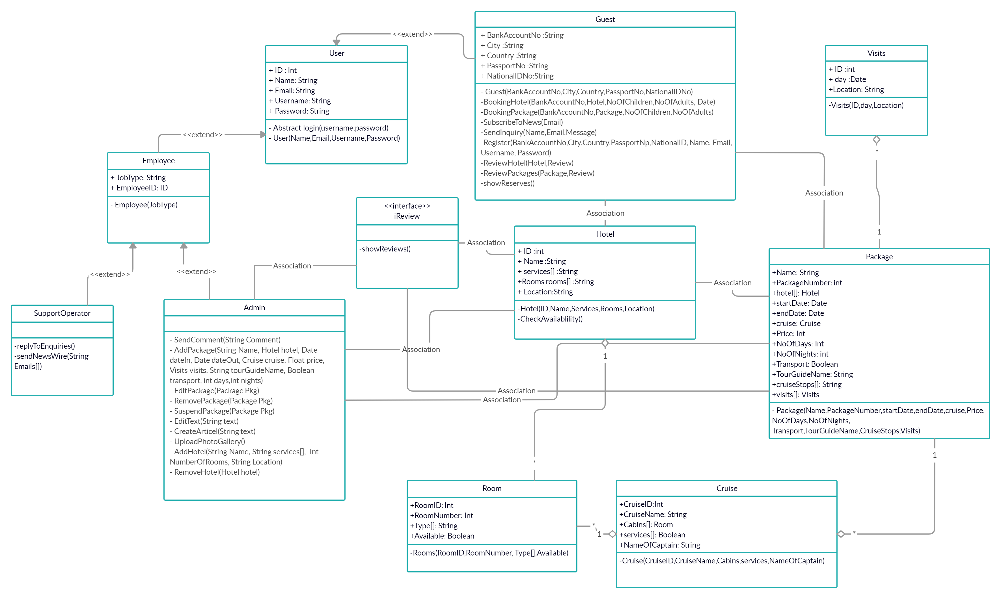
Class Diagram

Slide 7
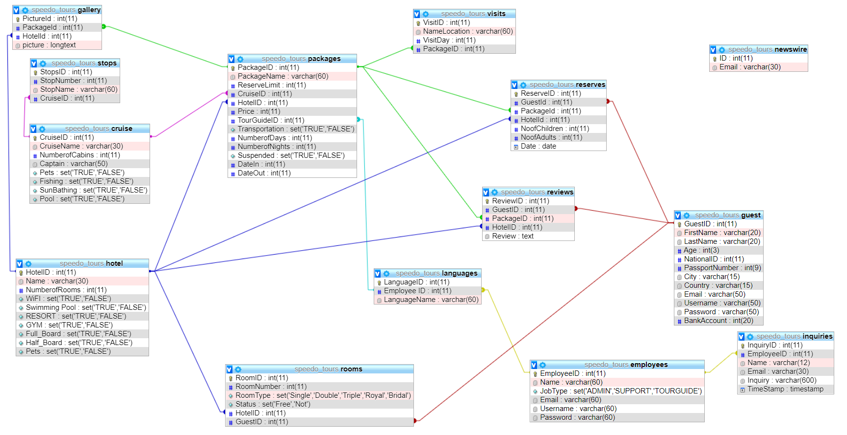
Database Diagram

Slide 8
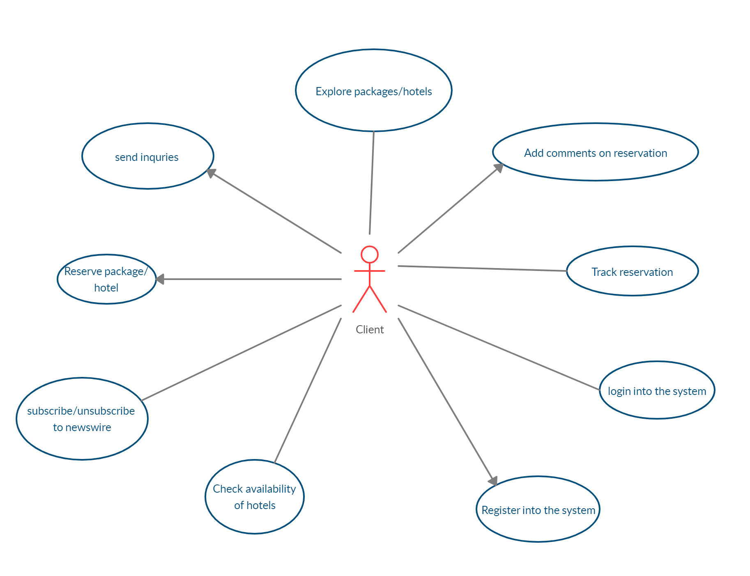
Use Case Diagram part 1

Slide 9
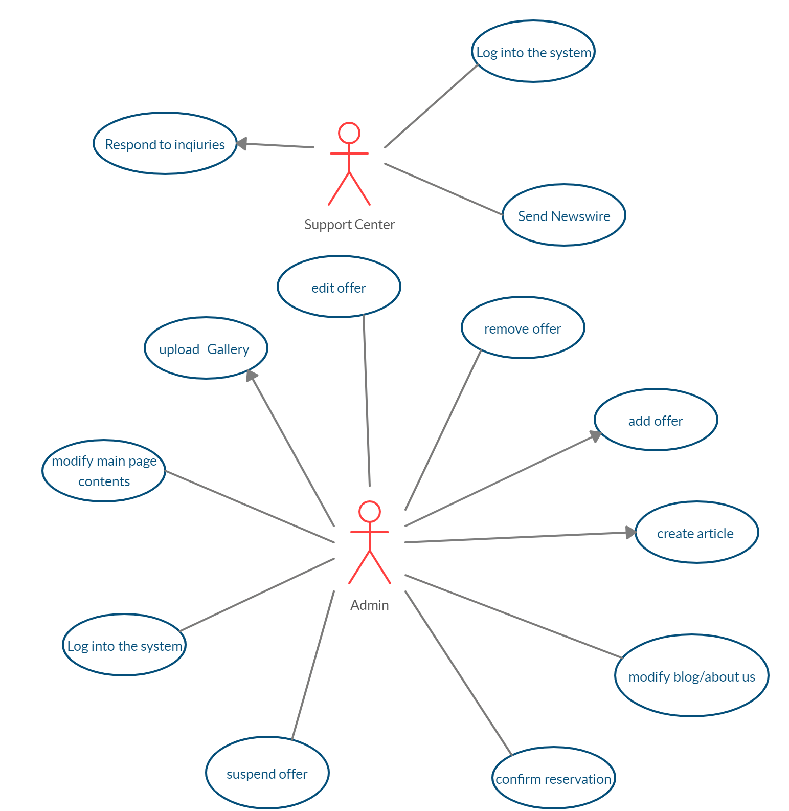
Use Case Diagram part 2

Slide 10
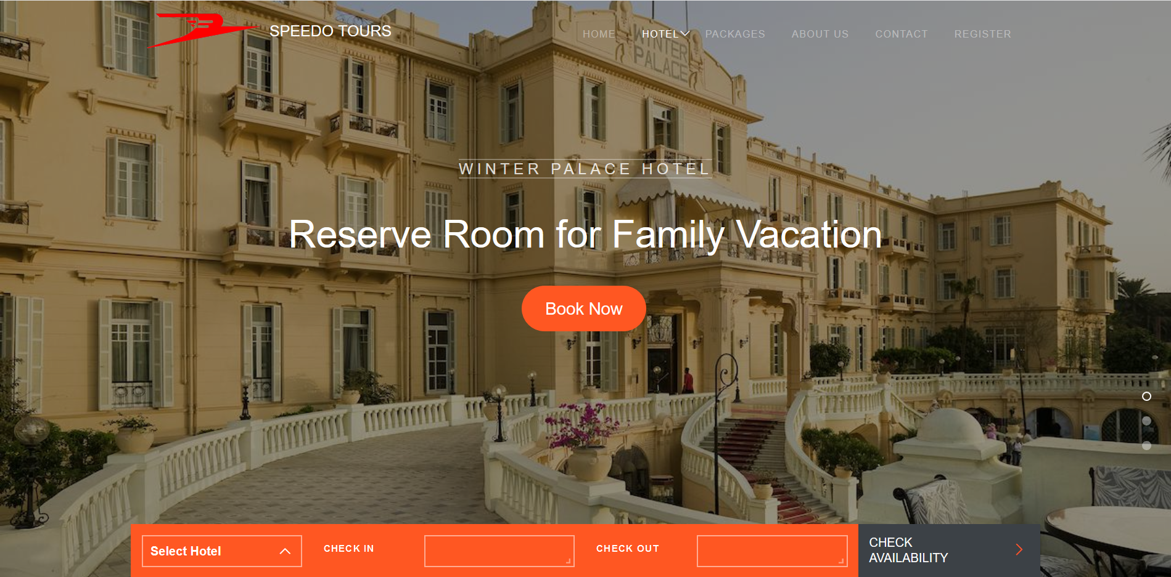
Frames (GUI)

Slide 11
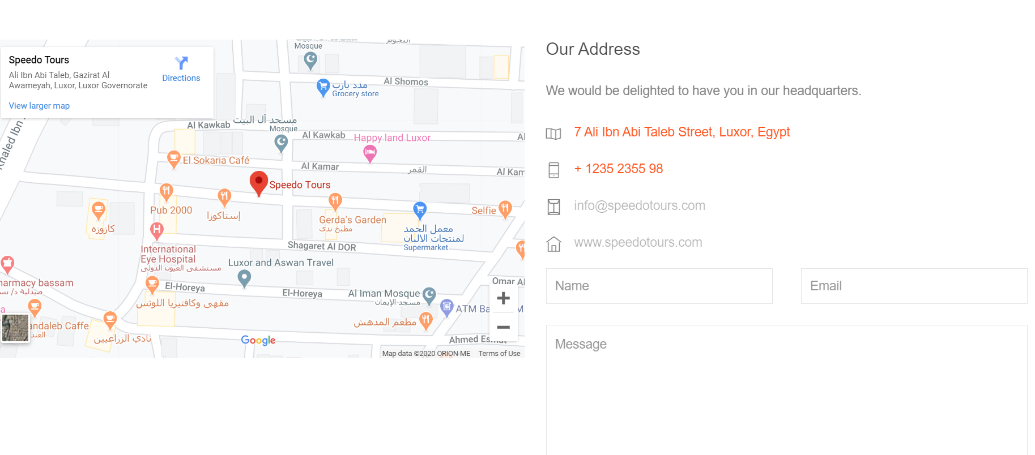
Frames (GUI)

Slide 12
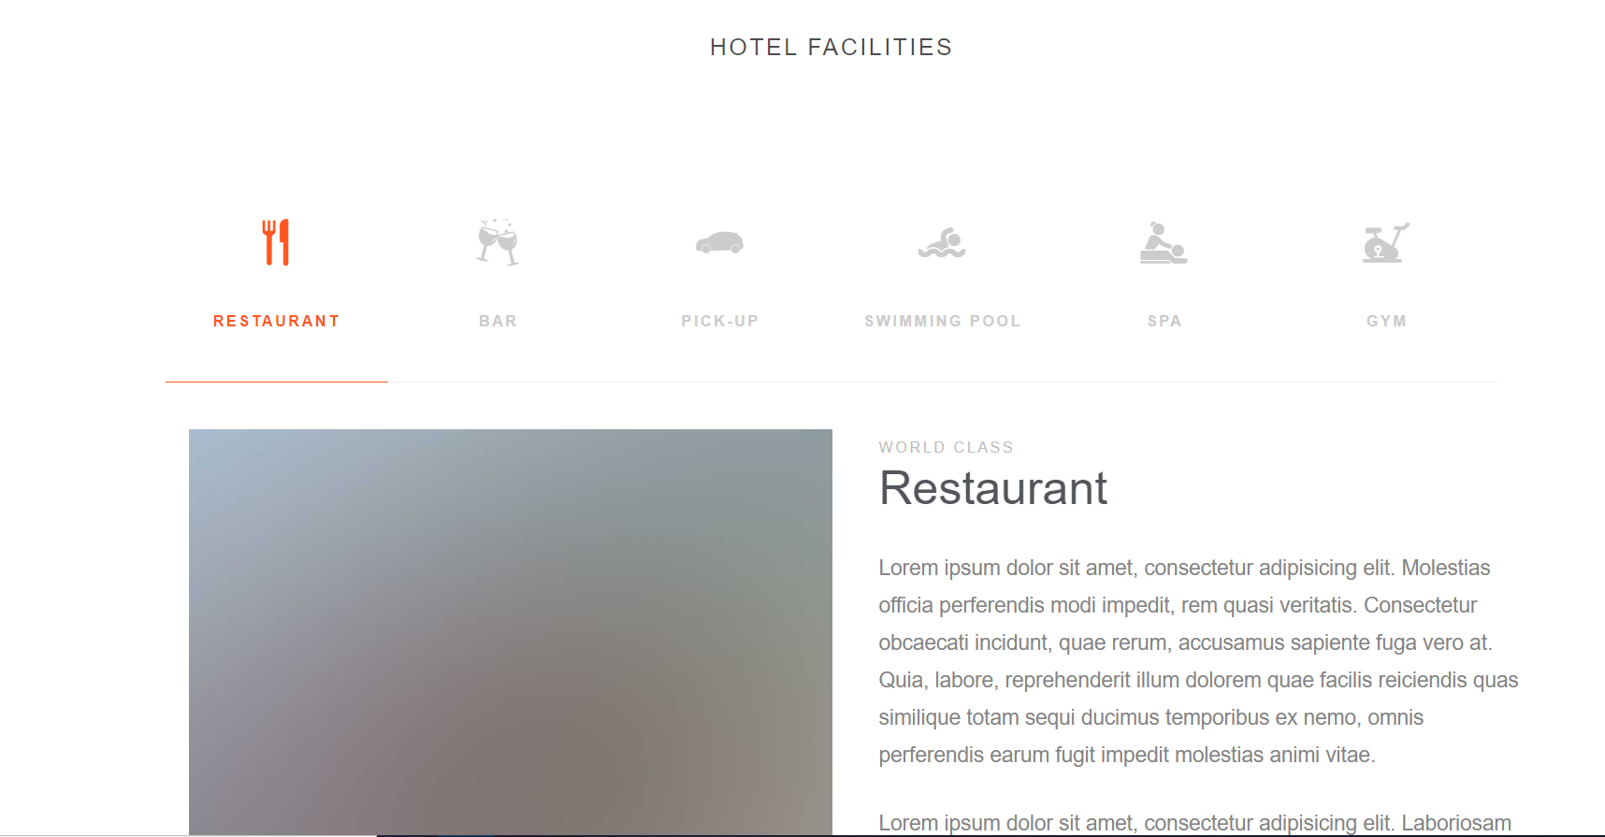
Frames (GUI)

Slide 13
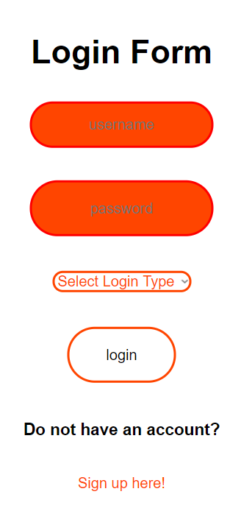
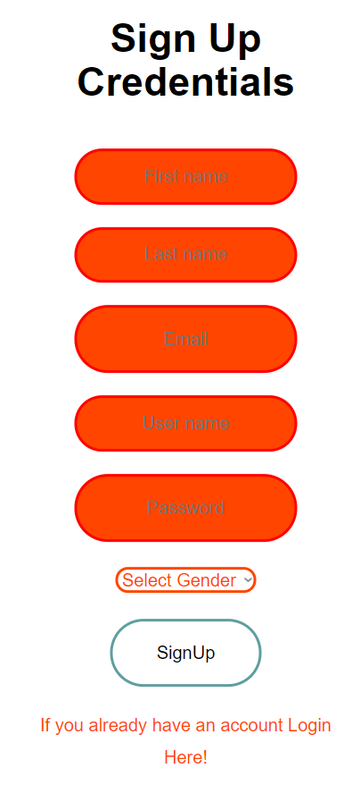
Frames (GUI)

Slide 14
THANK YOU
ANY MORE QUESTION ?

